Slide 1

Process flow of a Sales order
Sales order Creation ( Order Team ) VA01 ( Manually ) ZSD001N ( Bulk upload )
Pull BOM ( BOM Team ) ZMM123
Create Collection and run ( APE Team ) ZMM018 , ZMM019
Placing Purchase orders with that collection ( Purchase Team ) ZMM020
Material received in warehouse ( WMS )
Planning Schedule ( Planning Team ) ZPP003
Fetching Generation( ERP Team ) ZPP005
Fetching issues ( Raw material issues ) ( warehouse Team ( WMS )
Production
Cutting → Stitching → Assembly → Packing
FG Inbound
Shipment

Slide 2



END-TO-END
DECISION MAKING SYSTEM
Streamlining order to shipment process
http://10.3.0.24:8075

Slide 3


END-TO-END DECISION MAKING SYSTEM
Project Scope
Covers the full life cycle of an order
Order Management – Capturing customer orders and specifications
Purchase Process – Tracking raw material procurement
Warehouse Management – Inventory and raw material stock updates
Production Monitoring – Real-time tracking of manufacturing processes
Finished Goods Tracking – Monitoring output and quality metrics
Shipment – Logistics tracking and order dispatch
Purpose
To provide a centralized, data-driven platform for making accurate and timely business decisions across the production lifecycle.
Key benefits
Improved cross-functional visibility
Faster and data-driven decisions
Reduced lead time and costs
Better customer satisfaction
Execution Departments involved
Department Name | Purpose
Planning Department | Used to check material Availability and Cutting stop lines
Production Department | Used to check production Output quantities and PO completion and PO current status

Slide 4
Purchase Order Creation & Approval Process using ZMM020

Slide 5
END-TO-END DECISION MAKING SYSTEM PROCESS FLOW
Shipment
Orders
Completed
FG
Ongoing
Purchase
not start
Production
Warehouse

Slide 6
END-TO-END DECISION MAKING SYSTEM FUNCTIONALITIES
Order article quantity function based on CRD and PO , Article
Order
Send alerts to the Purchase and planning department while the warehouse has lack of material for the PO according the
planning schedule
Purchase
Visualizing ware house status in Status of PO order to shipment function
Visualizing Overall Count and Material Available count in Material Tracking Report
Identity Cutting , stitching , assembly stop lines before 3 days and send alert to the warehouse department
Visualizing material status for each material
Warehouse
Visualize production status with colour indication in PO Tracking report
Visualize size wise Cutting , stitching , assembly , packing output quantities and Status with colour indication
Production
Visualize FG output quantity for a PO and Status with colour indication
Finished Goods
Visualize shipment article quantity based on CRD , article and PO
Visualize shipment quantity and completion percentage with colour indication and Time line for shipmen
Shipment
Visualize timelines from order to shipment
The status with colour indication for bom , purchase , warehouse , cutting , stitching , assembly , packing , finished goods , shipment
Visualizing the size wise outputs and status with colour indication
Visualize the Outputs from Order to shipment and Completion percentage
Identify Left over stack and NO Need Pos for Production
Visualize PO Details with colour indication and Overall PO Status
PO Completion pie chart
Summary Reports

Slide 7

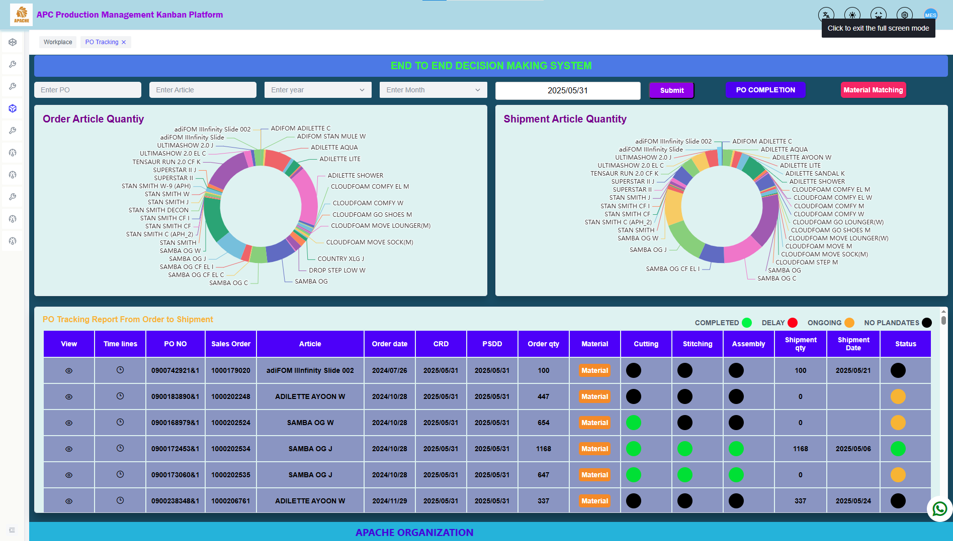

END-TO-END DECISION MAKING SYSTEM MAIN PAGE
Visualization of order article quantity based on CRD , article and PO
Visualize shipment article quantity based on CRD , article and PO
Visualize PO Details with colour indication and Overall PO Status

Slide 8
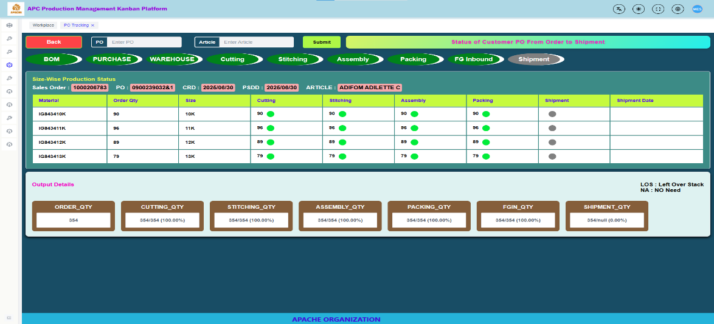
Summary Reports
Visualize the status for BOM , PURCHASE , WAREHOUSE , CUTTING , STITCHING , ASSEMBLY , PACKING , FG , SHIPMENT
Visualize size wise production outputs and shipment outputs with colour indication
Visualize Output quantities from order to shipment and completion percentage
Identify left over stack and No need Pos for Production

Slide 9
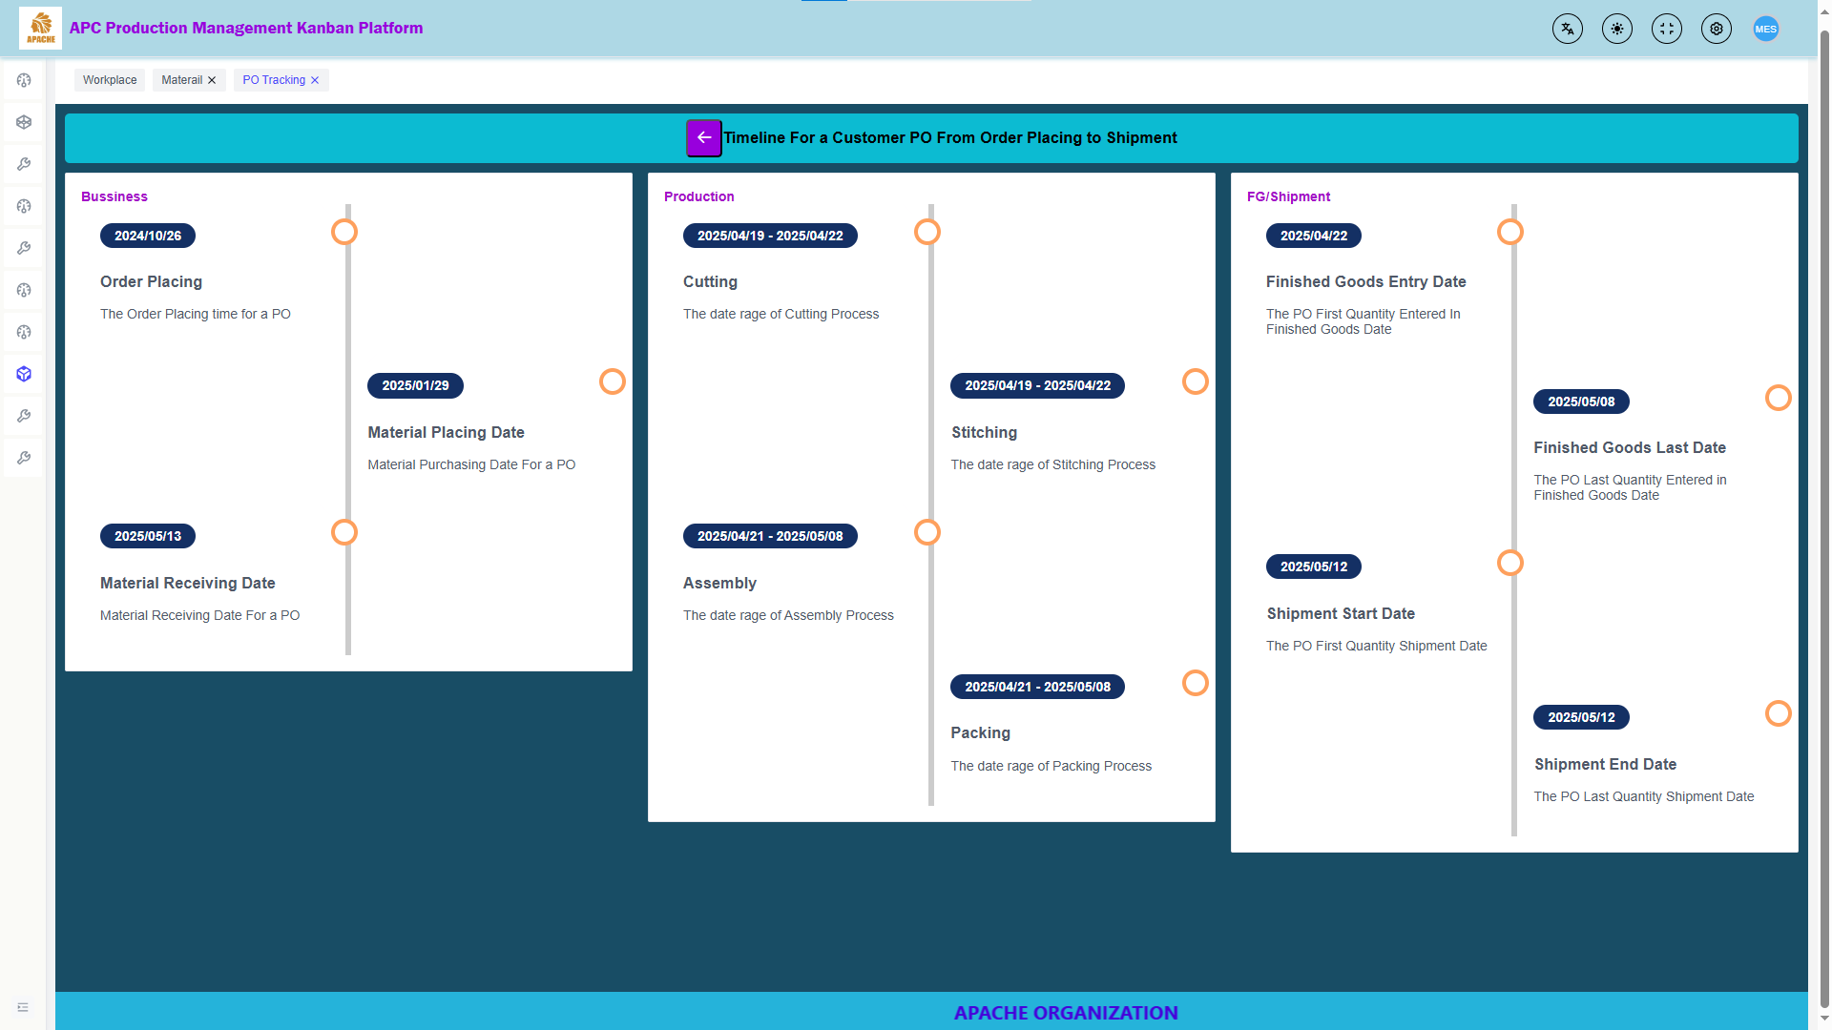
Summary Reports
Visualize the time lines for Business ( Order placing , Material placing and material receiving )
Visualize the time lines for Production ( Cutting , Stitching , assembly , packing )
Visualize the time lines for FG and shipment

Slide 10
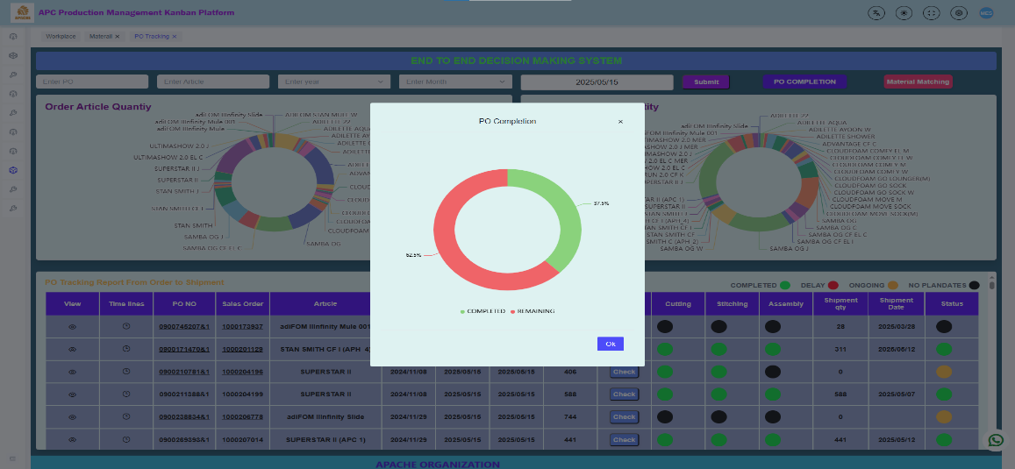
PO Completion Pie chart
Visualization of PO Completion Percentage and Pos Completion Count in Pie chart

Slide 11
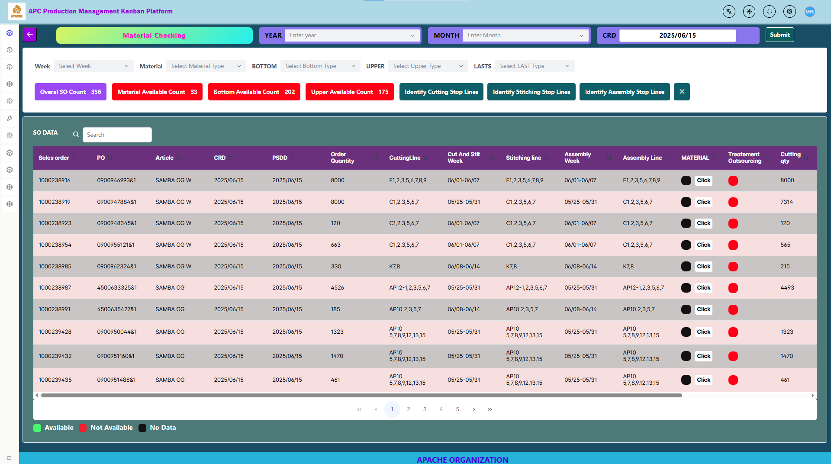


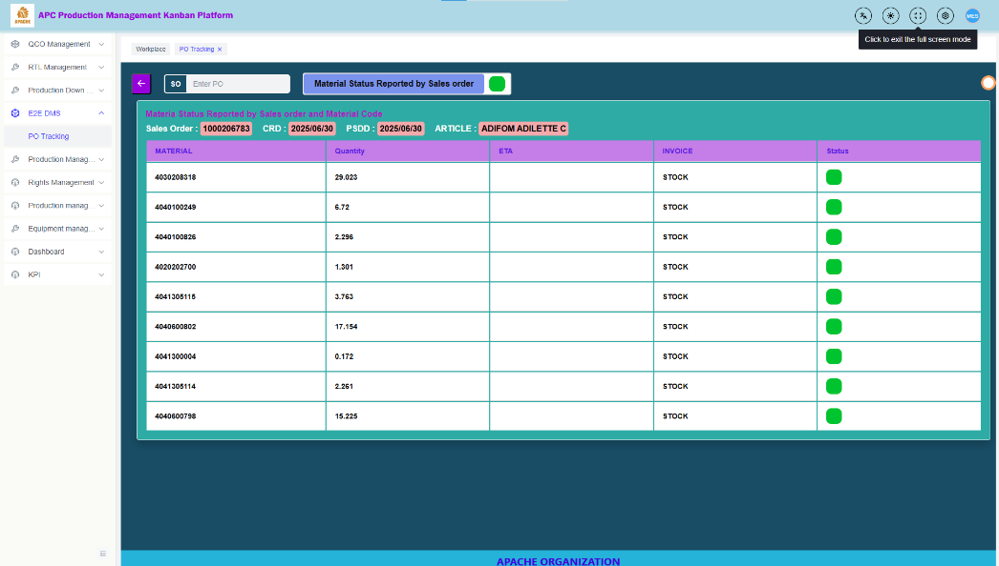
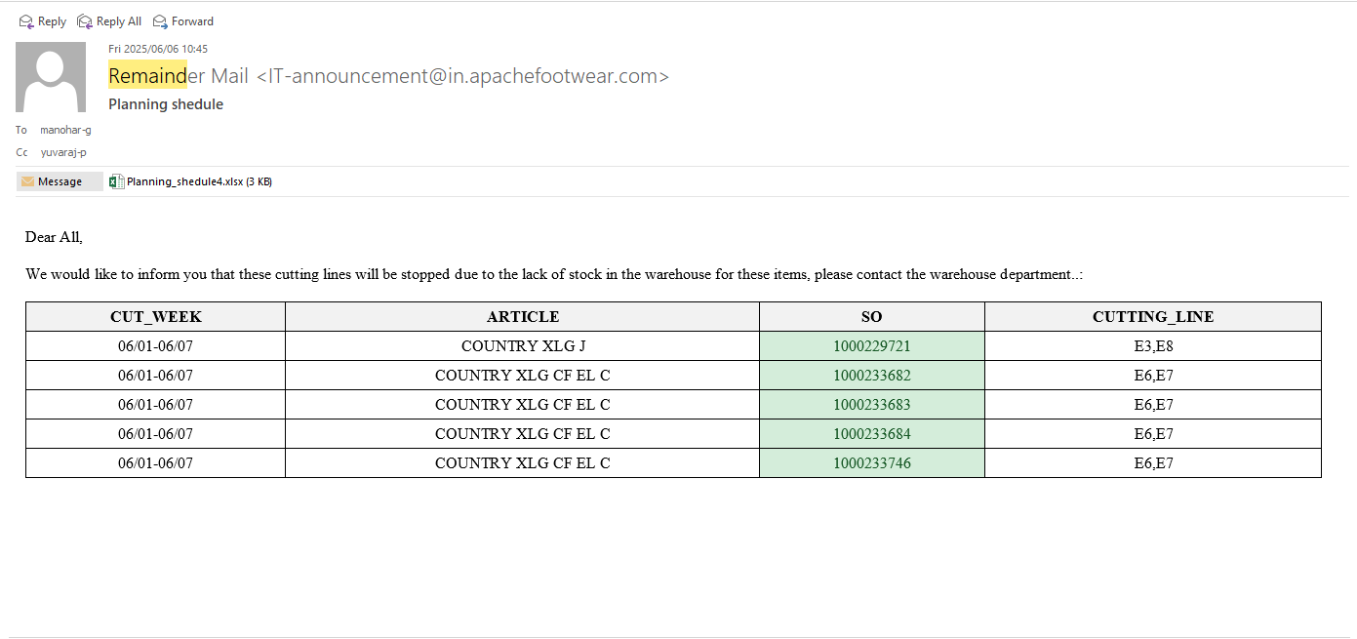
Identify Available material and not available material for Pos and send alerts to the planning department
identify cutting , stitching and assembly stop lines before 3 days
Identify Available and Not available Bottom and upper Pos count
Material Tracking
If any cutting lines are stopped due to lack of material, an alert is sent to the planning department every day.

Slide 12
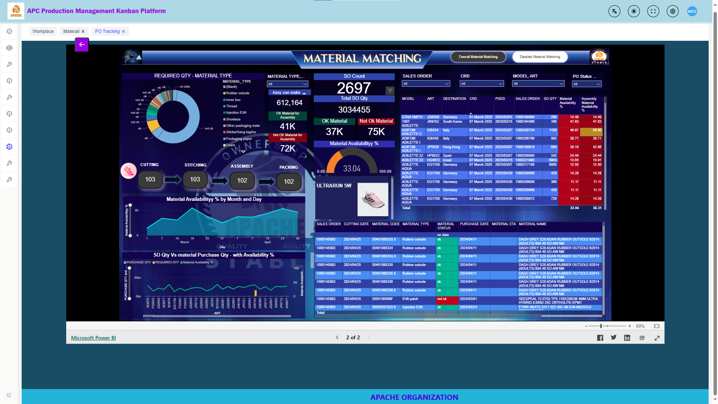
https://app.powerbi.com/view?r=eyJrIjoiYTI0NGQwZmQtMmVkNi00OTYwLTkzYzMtOTA4ODVkNWNmZjg0IiwidCI6IjQ4MWExNWMxLTk5OTItNGIyZC05YzdiLTIxMzA2N2Q2MjQ2NCJ9

Slide 13
END TO END DECISION MAKING SYSTEM TIME LINES
Phase | Item | Due Day | Status
Preparation | Project Initiation | 2025/04/16 | Close
Blueprint | Blue print Review | 2025/04/29 | Close
Realization | Function Development | 2025/07/15 | Ongoing
Realization | Unit Test IT | 2025/07/30 | Not Started
Realization | Unit Test Biz | 2025/08/05 | Not Started
Realization | User Acceptance Test | 2025/08/10 | Not Started
Final Preparation | Go-live Readiness and Review | 2025/08/16 | Not Started
Post-Production Support | Go-live | 2025/08/20 | Not Started
PPS | Project Exit | 2025/08/30 | Not Started

Slide 14


